Slide 1
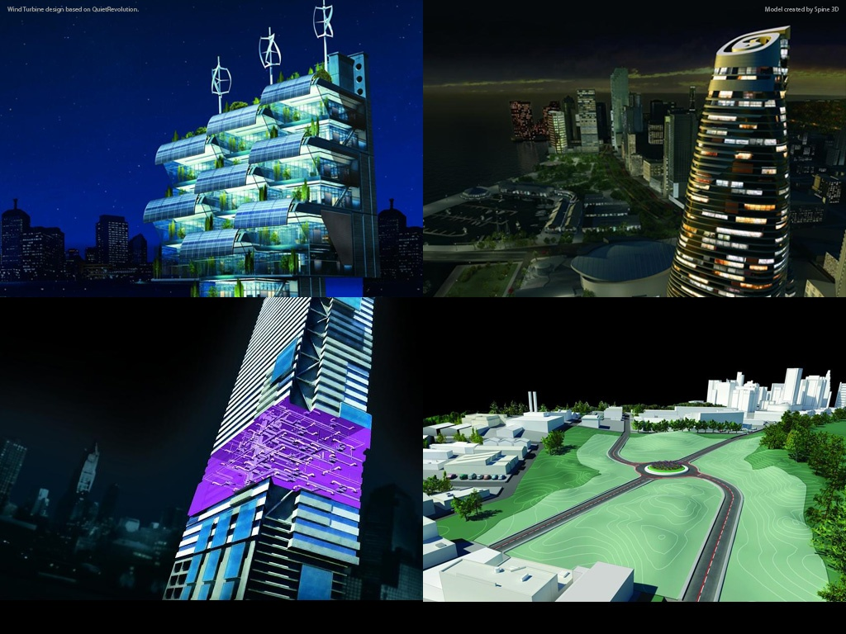
Bridge Design in AutoCAD Civil 3D
Tony Huang, Abraham Xu, Charles Zuo
SWD
Civil 3D
Notes:
Bridge Modeling Design in Civil 3D

Slide 2
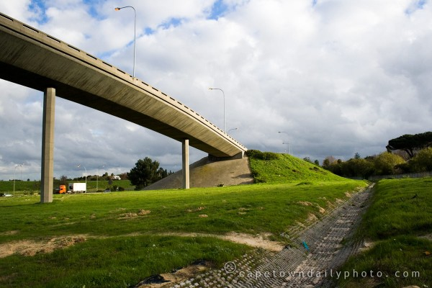
Background
Notes:
Civil3D can’t solve problem of designing bridge. But Civil3D is good at modeling the road. So I consider, why not use Civil3D to model some bridges which are similar to the roads?

Slide 3
Agenda
Bridge types & scope
How to design a bridge
What can Civil 3D do in the bridge designing
Proposed Work Flow of Modeling
Structure Analysis
Drawings & Reports
Overview
Notes:
I will introduce the bridge types and our scope, how to design a bridge, what can Civil3D do in the bridge designing.
As the Civil3D is good at modeling, the focus of this ppt will be in work flow of bridge modeling.

Slide 4
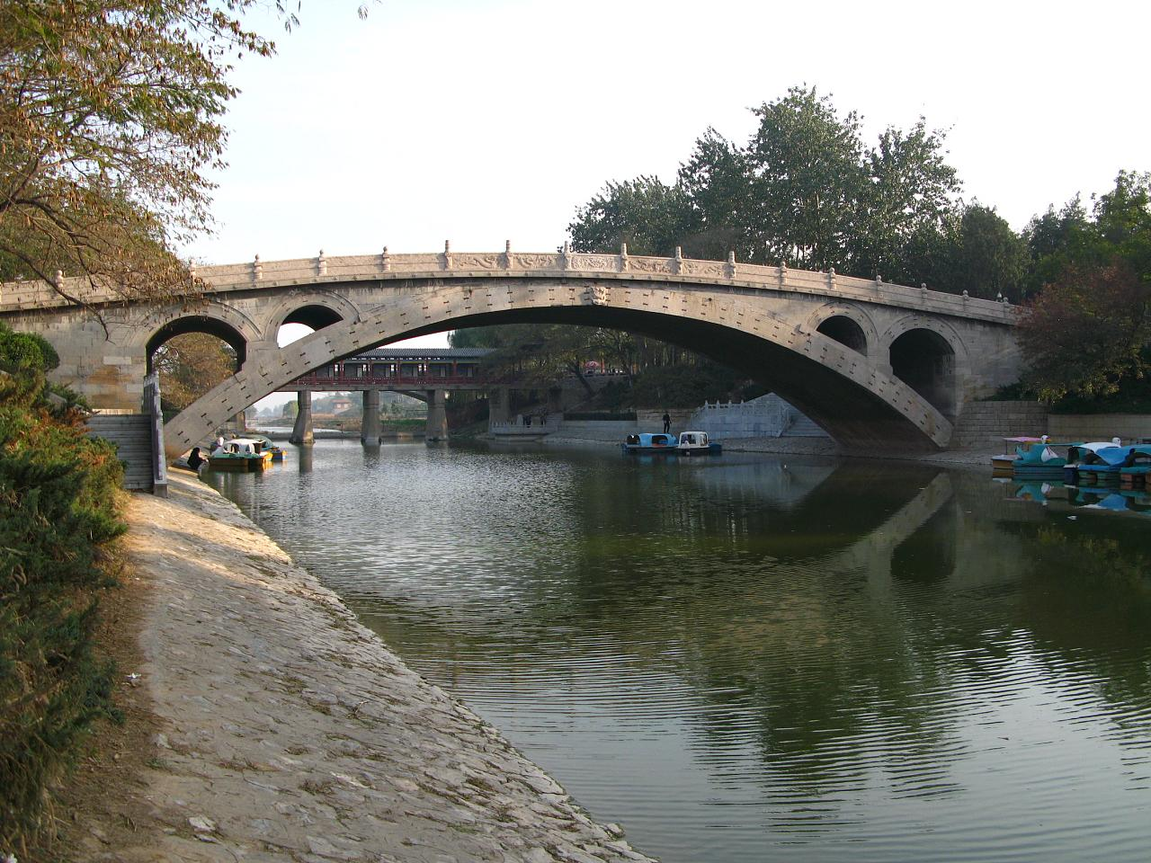
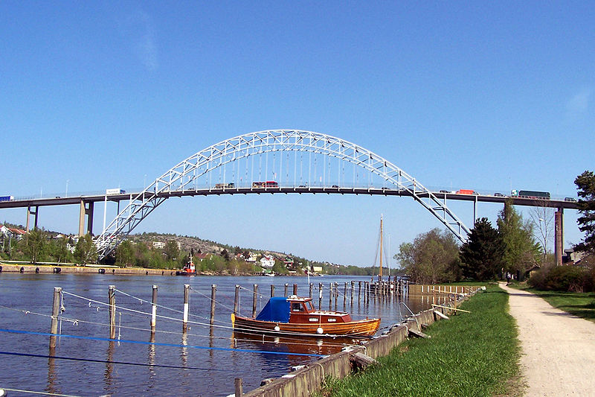
Bridge Types
Arch Bridge
Suspension Bridge
Cable-stayed Bridge
Continuous Tress Bridge
Notes:
An arch bridge is a bridge with abutments at each end shaped as a curved arch. Arch bridges work by transferring the weight of the bridge and its loads partially into a horizontal thrust restrained by the abutments at either side.
Zhaozhou Bridge, Fredrikstad Bridge Norway腓特烈斯塔（挪威东南部海港）

Slide 5
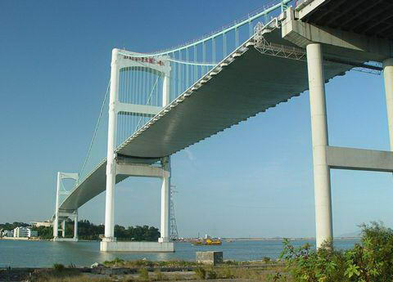

Bridge Types
Arch Bridge
Suspension Bridge
Cable-stayed Bridge
Continuous Tress Bridge
Notes:
A suspension bridge is a type of bridge in which the deck (the load-bearing portion) is hung below suspension cables on vertical suspenders.
Shantou Bridge, Bosphorus Bridge in Istanbul博斯普鲁斯大桥(伊斯坦布尔)

Slide 6
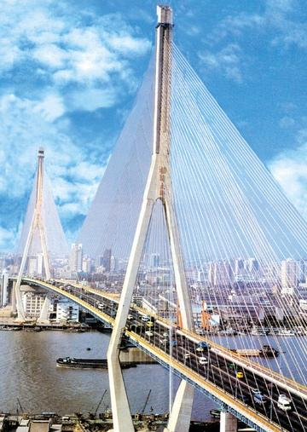

Bridge Types
Arch Bridge
Suspension Bridge
Cable-stayed Bridge
Continuous Tress Bridge
Notes:
A cable-stayed bridge is a bridge that consists of one or more towers, with cables supporting the bridge deck.
Yangpu Bridge, Rama VIII Bridge (罗摩8)

Slide 7
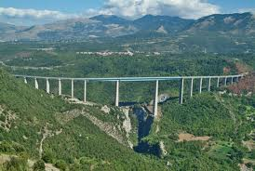
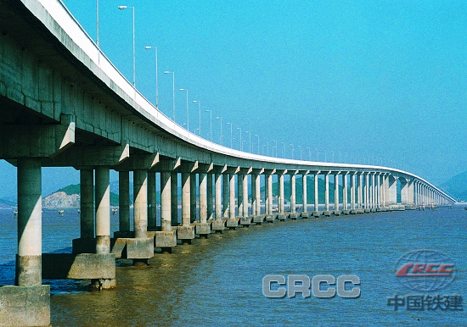
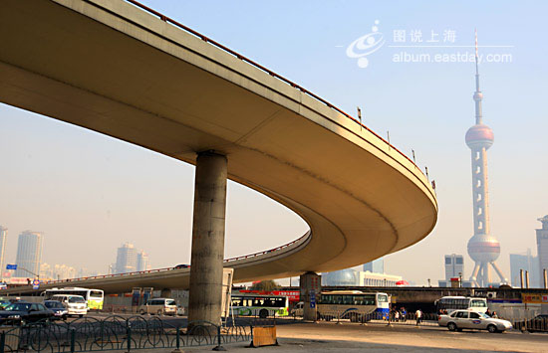
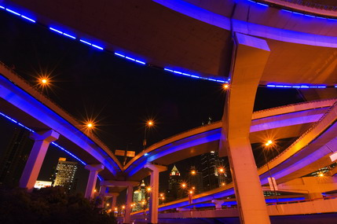
Bridge Types & Scope
Arch Bridge
Suspension Bridge
Cable-stayed Bridge
Continuous Truss Bridge
------ Scope
Notes:
Truss and Continuous Truss Bridge
As a bench, doesn’t have arch curves, has no big towers or cables. All of the loads are through the supports transfer to the ground.
To design a continuous truss bridge is our scope.

Slide 8
How to design a bridge
Notes:
Conceptual design
In this step, both model type and structure type of bridge will be selected. And coarse bridge model will be designed for prototype.
Modeling and structure analysis, redesign
It includes load-bearing, material, aseismic and anti-wind analysis, etc. Based on these analysis results, designers will refine the model and get accurate design ready for construction. The final design comes out with several iterations.
Construction & project reports
Calculating normal reinforced and prestressed reinforced of every structures. Make the construction process management plan. Submit the drawings and the project reports.

Slide 9
How to design a bridge
Cooperation between road engineer and bridge engineer
Step 1
Step 2
Aim
Design Bridge
Design Road
Design Road
Design Bridge
Save the construction cost
Enhance driving comfort and security
Notes:
Another point I have to say, the working way between road engineer and bridge engineer has changed.
In the old way, bridge engineer determine the location where building a bridge first, and then road engineer design a road to adapt to the bridge. (Sometime this way is still used, when designing the especially large bridge.) It is in order to save the construction cost.
But now, more and more is designing road at the first, and then set up bridge. It is in order to enhance driving comfort and security.

Slide 10
Proposed Work Flow in Civil 3D
Civil3D
Modeling
Structure
Analysis
(RSA)
(RST)
(ASD)
Alignment
Design conditions
Profile
Gravity load
Wind load
Shock
Brake load
Assembly
Mechanics
SAC
Bridge
Section
Compressive
Road
Section
Bending
Shearing
Corridor
Material
Intersection
Steel
Foundation design
Reinforced concrete
...
Supports
...
Prestressed concrete
...
Foundation
...
Drawings & Reports
Notes:
Most of the work flow is the same as road designing. In the left picture, the yellow parts are newly added. When designing the assembly, we will design the bridge section and the road section. By the way, we can easily create section of the bridge by using the Subassembly Composer.
The corridor will separate into several parts, parts are bridge, and parts are roads.
This intersection is the ramps and interchanges.
After building the corridor and design the intersection, we will design the bridge supports and the foundation.
And these several parts will influence each other. If increase the distance between the supports, the bridge section will be higher, the foundation may also be bigger and deeper. And the size of these assemblies are depend on a lot of conditions, something like the load conditions, the mechanics, the material of the bridge, etc. And all of these conditions will be analysis by the structure analysis software, as RSA, RST, ASD, or other company's professional bridge software.
Finally, the designer will submit the drawings and the project reports.
RSA : Autodesk Robot Structural Analysis Professional
RST : Autodesk Revit Structure
ASD : AutoCAD Structural Detailing

Slide 11
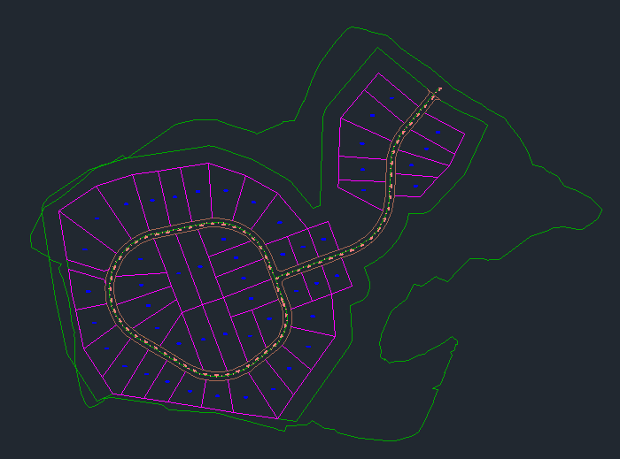
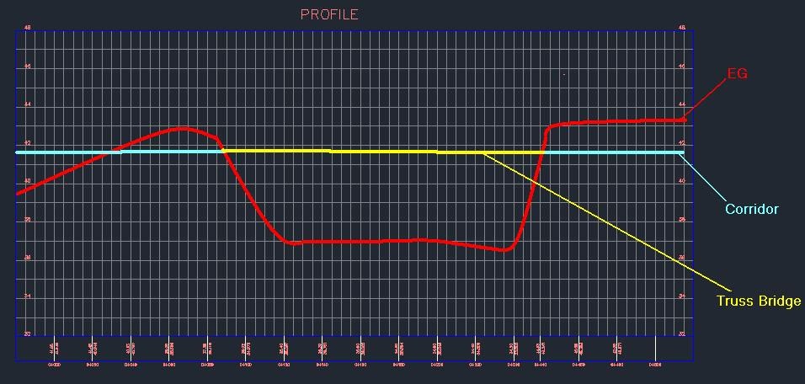
Alignment
Profile
Notes:
First of all, the road engineer will design an alignment and profile as designing a normal road. And then the bridge engineer will get the data from the road design. In the profile, parts of them will be marked as bridges.
Any way the profile can be separated from the ground, so it will be more gently.

Slide 12
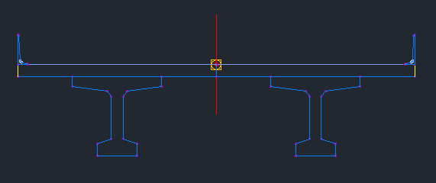
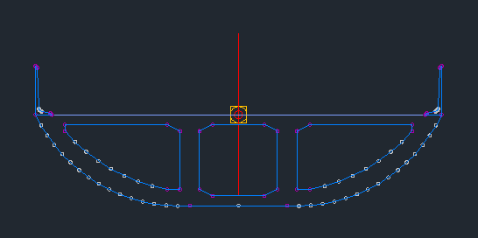
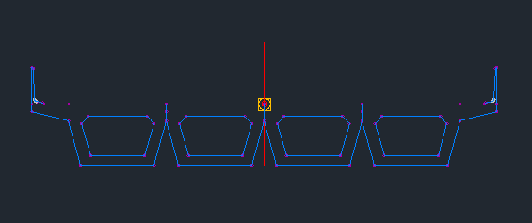
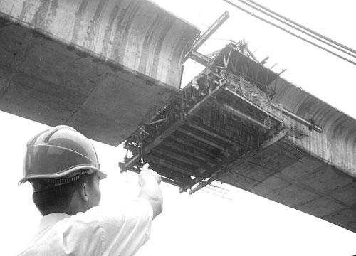
Assembly
Bridge
Section
Notes:
Here are some types of the bridge sections.
The first one is an independent box-girder while has both arc sides. This type is usually used in city, because it’s modeling beautiful.
The second one is an I-Beam. The material of this one is concrete, and some of I-Beam is steel. The coverage in the above of I-Beam is the concrete slab.
The last one is another type of box-girder, which is made up by many boxes. And these can be made in the factory, and then transported to the location and installing.
By the way, in the section, the balustrades are indispensable.

Slide 13
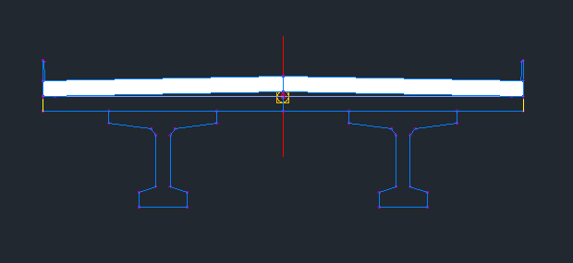
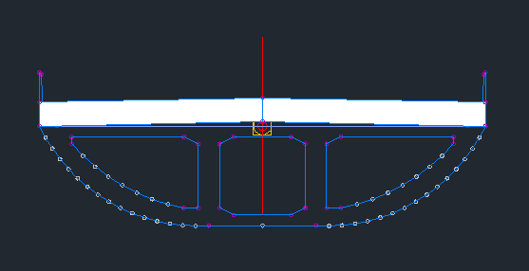
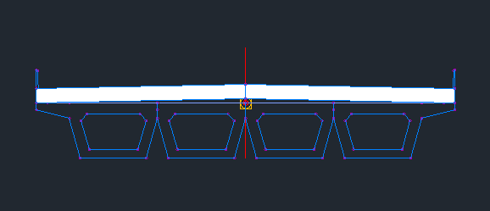
Assembly
Road
Section
Notes:
And then add the road section on the top of the bridge section. And it is simple than the normal road designing, because don't need to design Shoulders, Daylight.

Slide 14
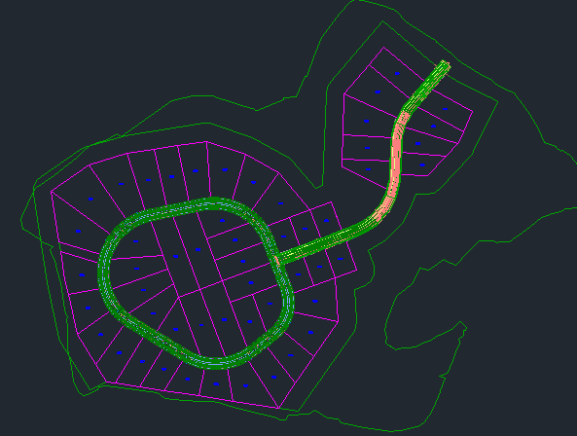
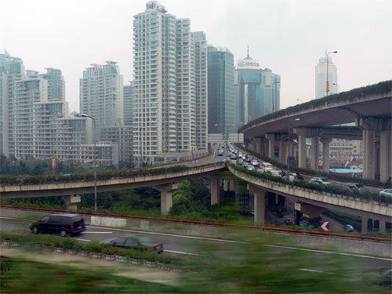
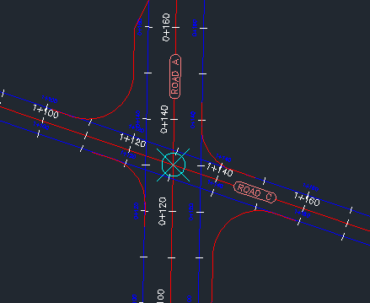
Corridor
Intersection
Notes:
The corridor will separate into several parts, parts are roads, and parts are bridges. The middle part is the bridge, others are roads.
This intersection need to add some other types, as the ramps and interchanges.

Slide 15
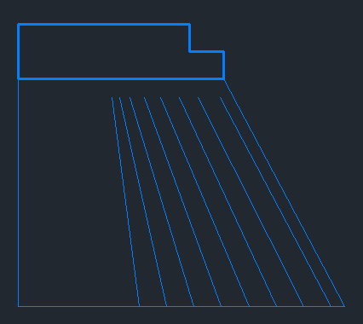
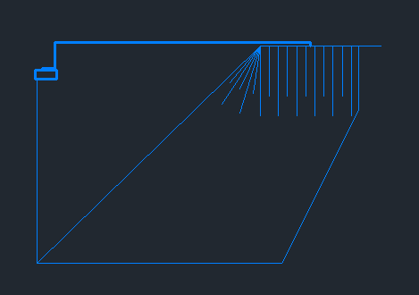
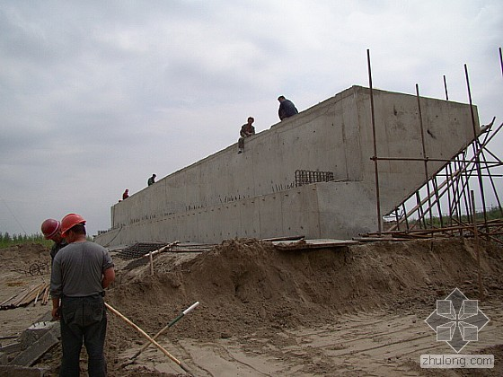
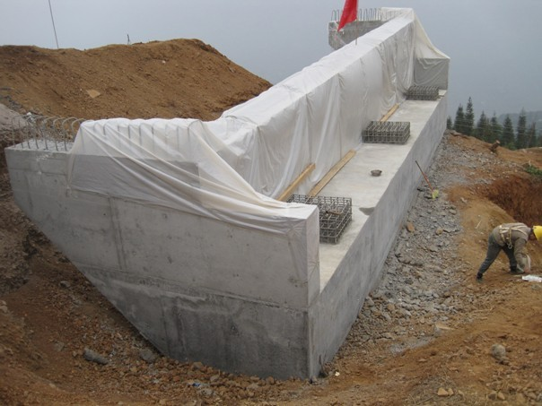
Supports
Notes:
Here are two types of ending supports. The I-Beam or box-girder are supports on here. And the other end is connecting the road.

Slide 16
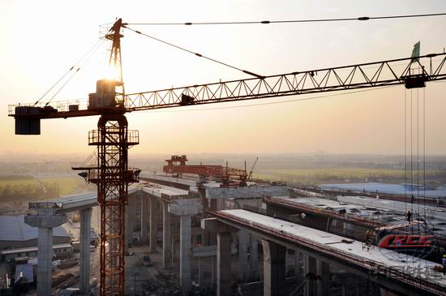
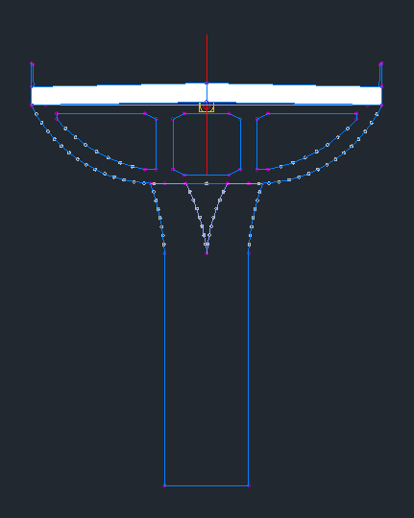
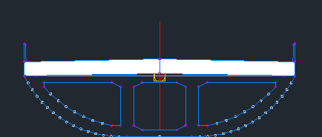
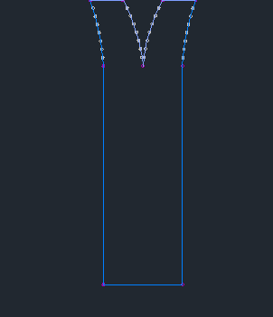
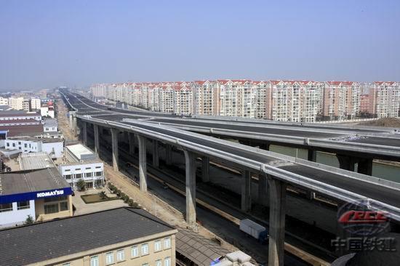
Supports
Notes:
In the urban elevated bridge, the bottoms of the bridge support will usually are small, like this. Because there are some other roads under the elevated bridges.

Slide 17
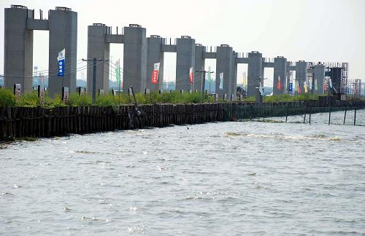
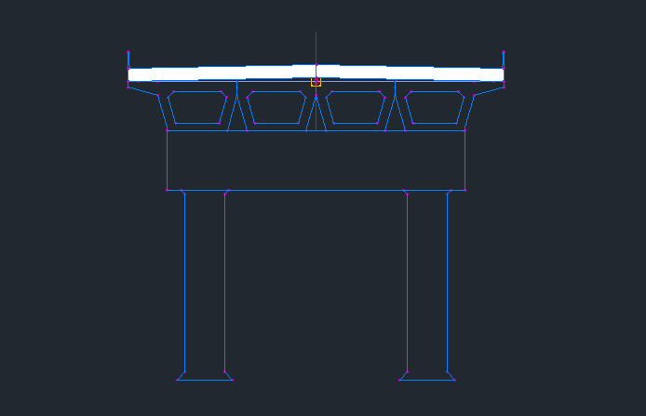
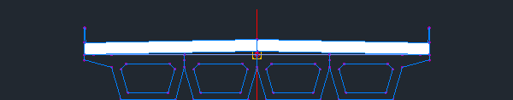
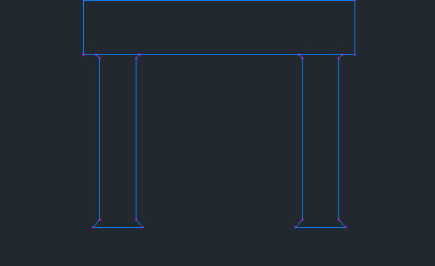
Supports
Notes:
If the bridge deck is wider, these types supports may be choose. Here are the supports of Railway Bridge in the above picture. The picture below is the bridge across the sea.

Slide 18
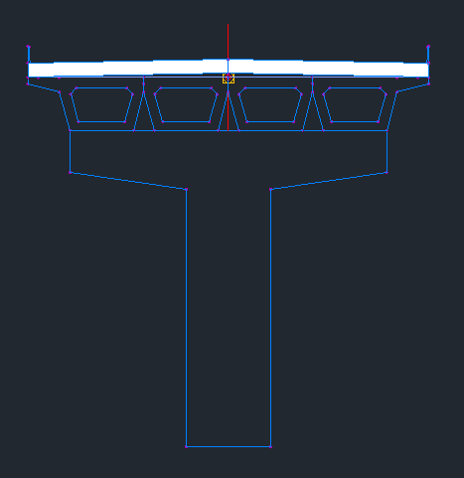
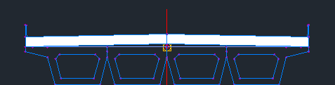
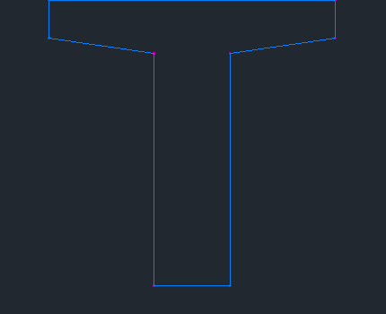
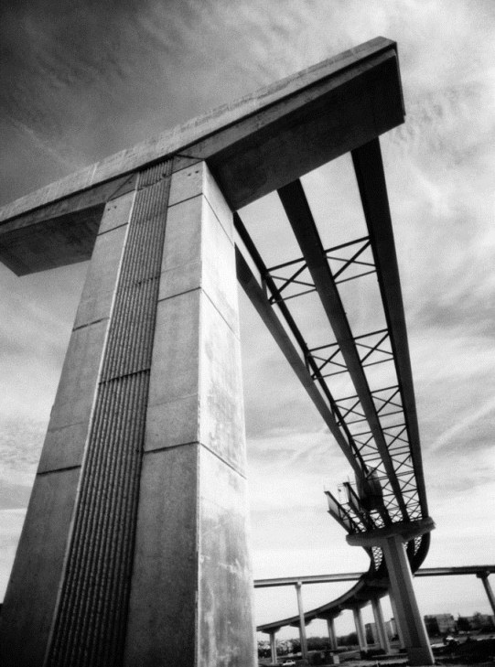
Supports
Notes:
Another type of supports.

Slide 19
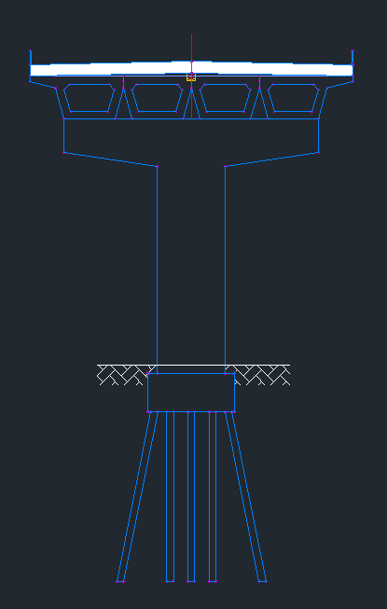
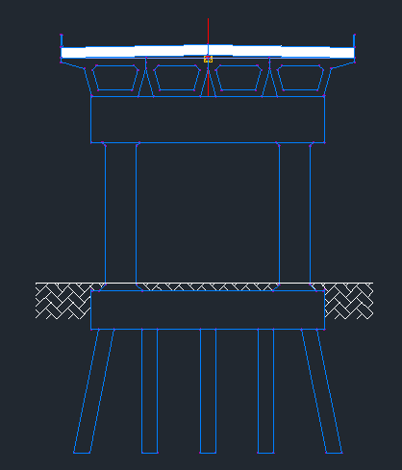
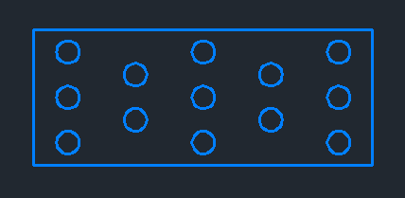
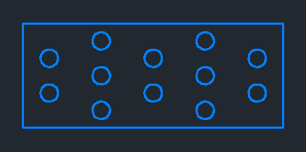
Foundation
Notes:
Foundation and piles. The piles are produced in the factory, and transported to the location and then machine drive piles into the earth. The size and types of foundation depend on the geological conditions.
There are two kinds of piles distribution modes.

Slide 20
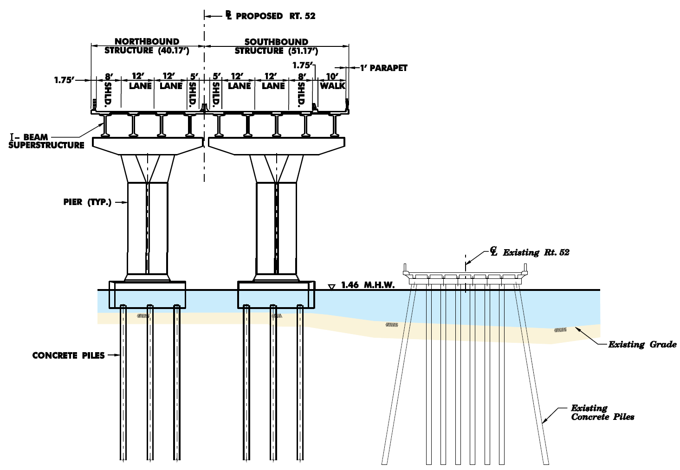
Modeling
Notes:
All the models are complete. In this picture, the I-Beam, the slab and the road section are continuous. The supports, the foundation and the piles are independence.

Slide 21
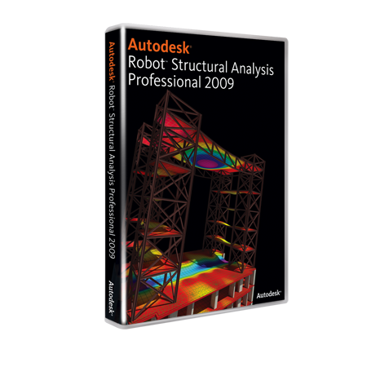
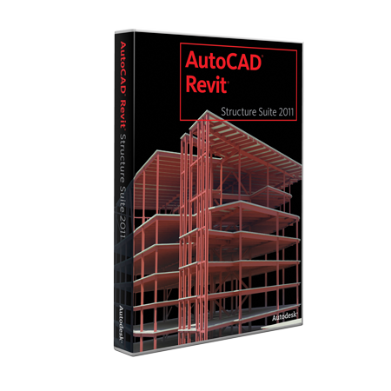

Structure
Analysis
Notes:
RSA : Autodesk Robot Structural Analysis Professional
RST : Autodesk Revit Structure
ASD : AutoCAD Structural Detailing
If necessary, we can provide the interface, and output the 3d model of the bridge. So that some other Finite Element Analysis software (as ANSYS, ADINA) and other bridge software (as Midas Bridge, Lucas) can use the model to do the structure analysis. (In this way, the bridge engineer will not change the existing Usage and Attitude. And our software will easier to be promotion.)

Slide 22
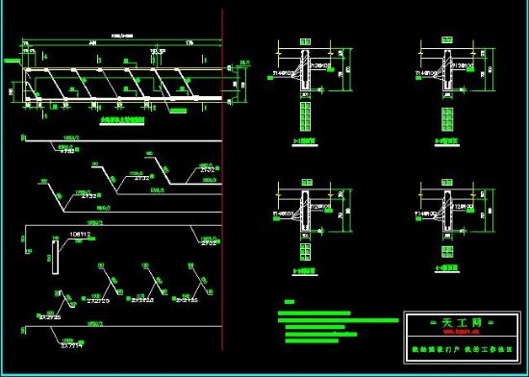
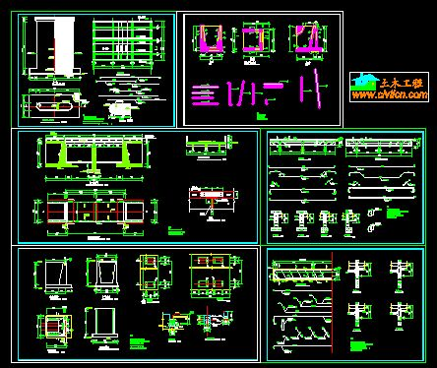
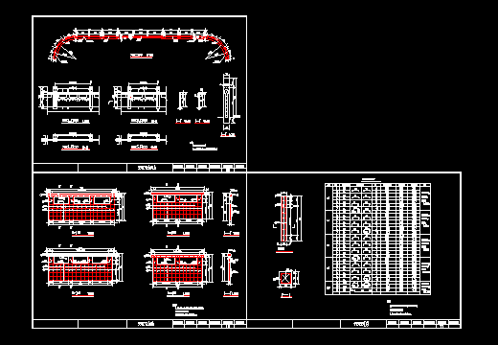
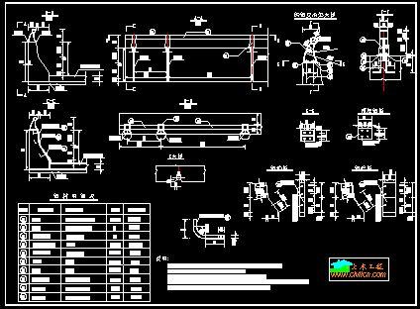


Drawings
Reports
Notes:
And then designer can use Civil3D to output the drawings and Reports.

Slide 23
Overview
Bridge
Section
Supports
Foundation
Continuous Tress Bridge
Arch Bridge
Suspension Bridge
Cable-stayed Bridge
Notes:
These three parts are newly added, Bridge section, Supports, Foundations. And we need to improve the Corridor and Intersection.
After that we can model the tress bridge in Civil 3D. If add more structure types, we can model all of the bridge types.

Slide 24
Civil3D
Modeling
Structure
Analysis
(RSA)
(RST)
(ASD)
Work Flow
Alignment
Design conditions
Profile
Gravity load
Wind load
Shock
Brake load
Assembly
Mechanics
SAC
Bridge
Section
Compressive
Road
Section
Bending
Shearing
Corridor
Material
Steel
Foundation design
Intersection
Reinforced concrete
...
Supports
...
Prestressed concrete
...
Foundation
...
Drawings & Reports

Slide 25
Q & A

